Slide 1
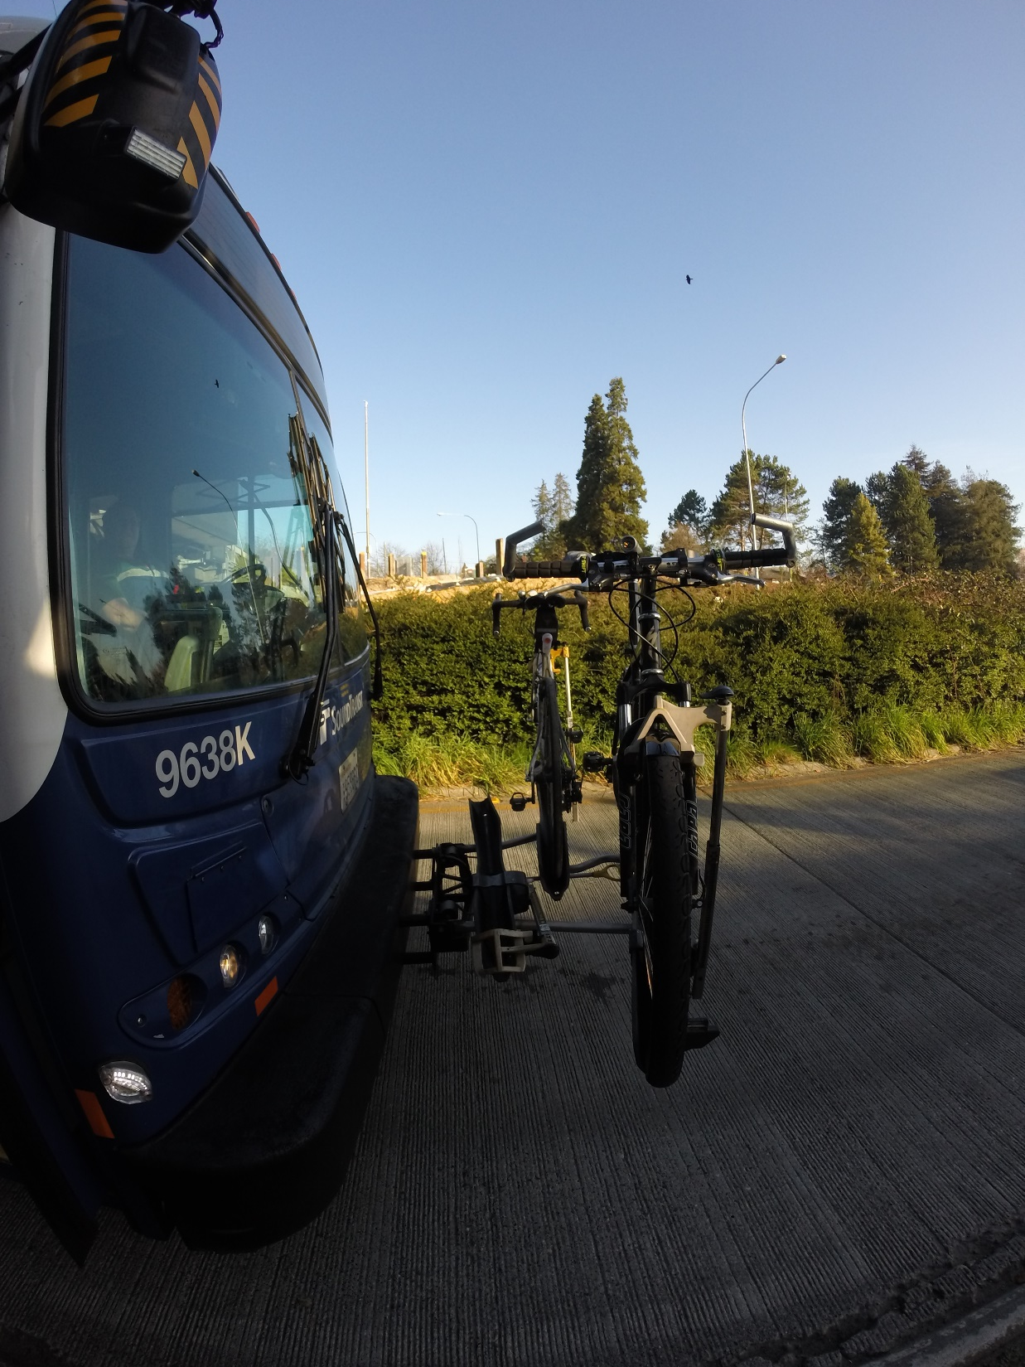



#bikeraxx Sensing bikes on buses
Alex Gingras, UW
Max Golub, UW
Dan Liebling, Microsoft Research
Rob Smith, Amazon

Slide 2
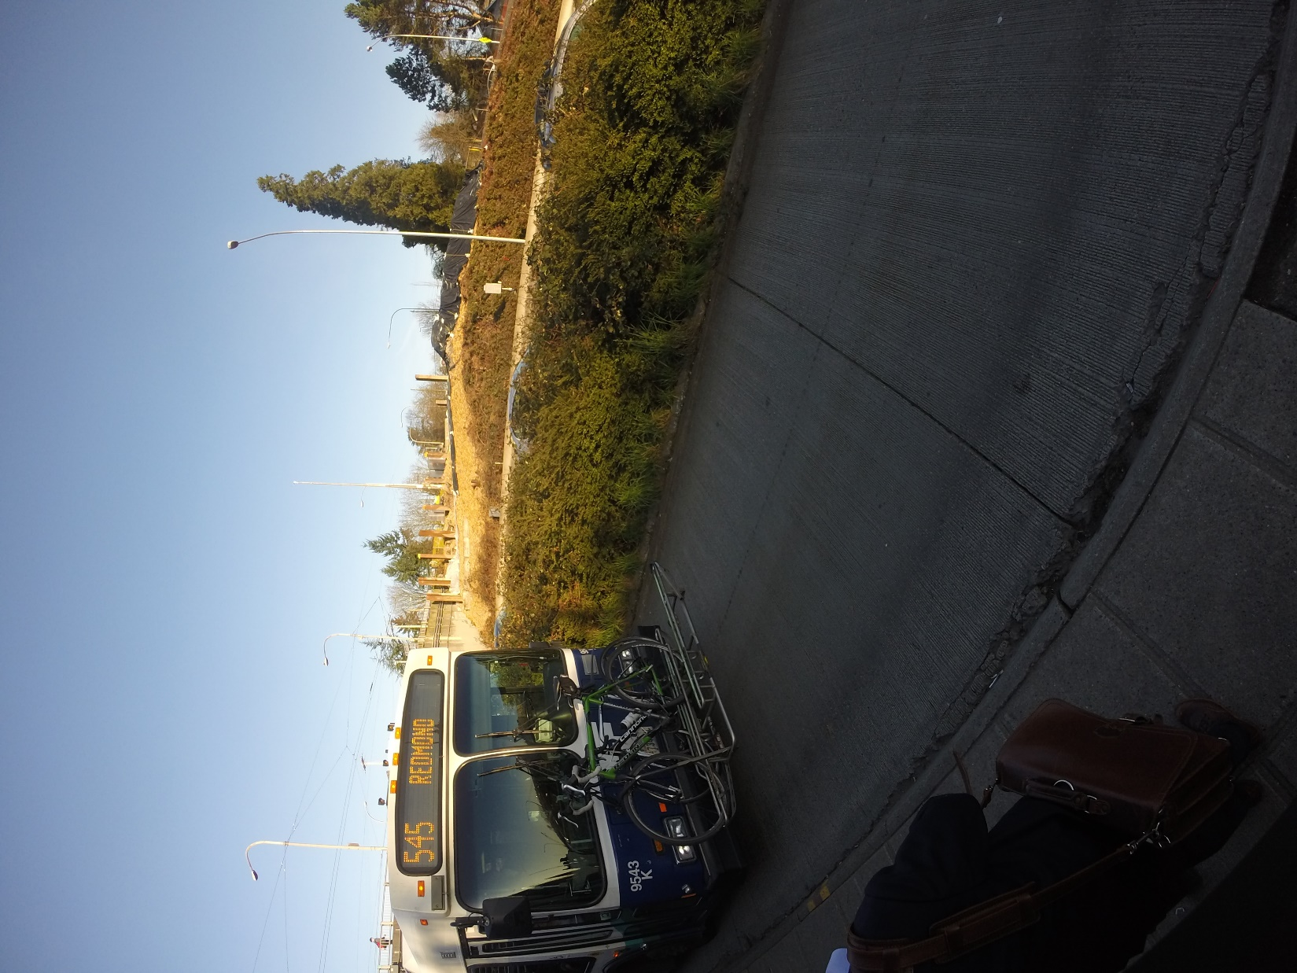
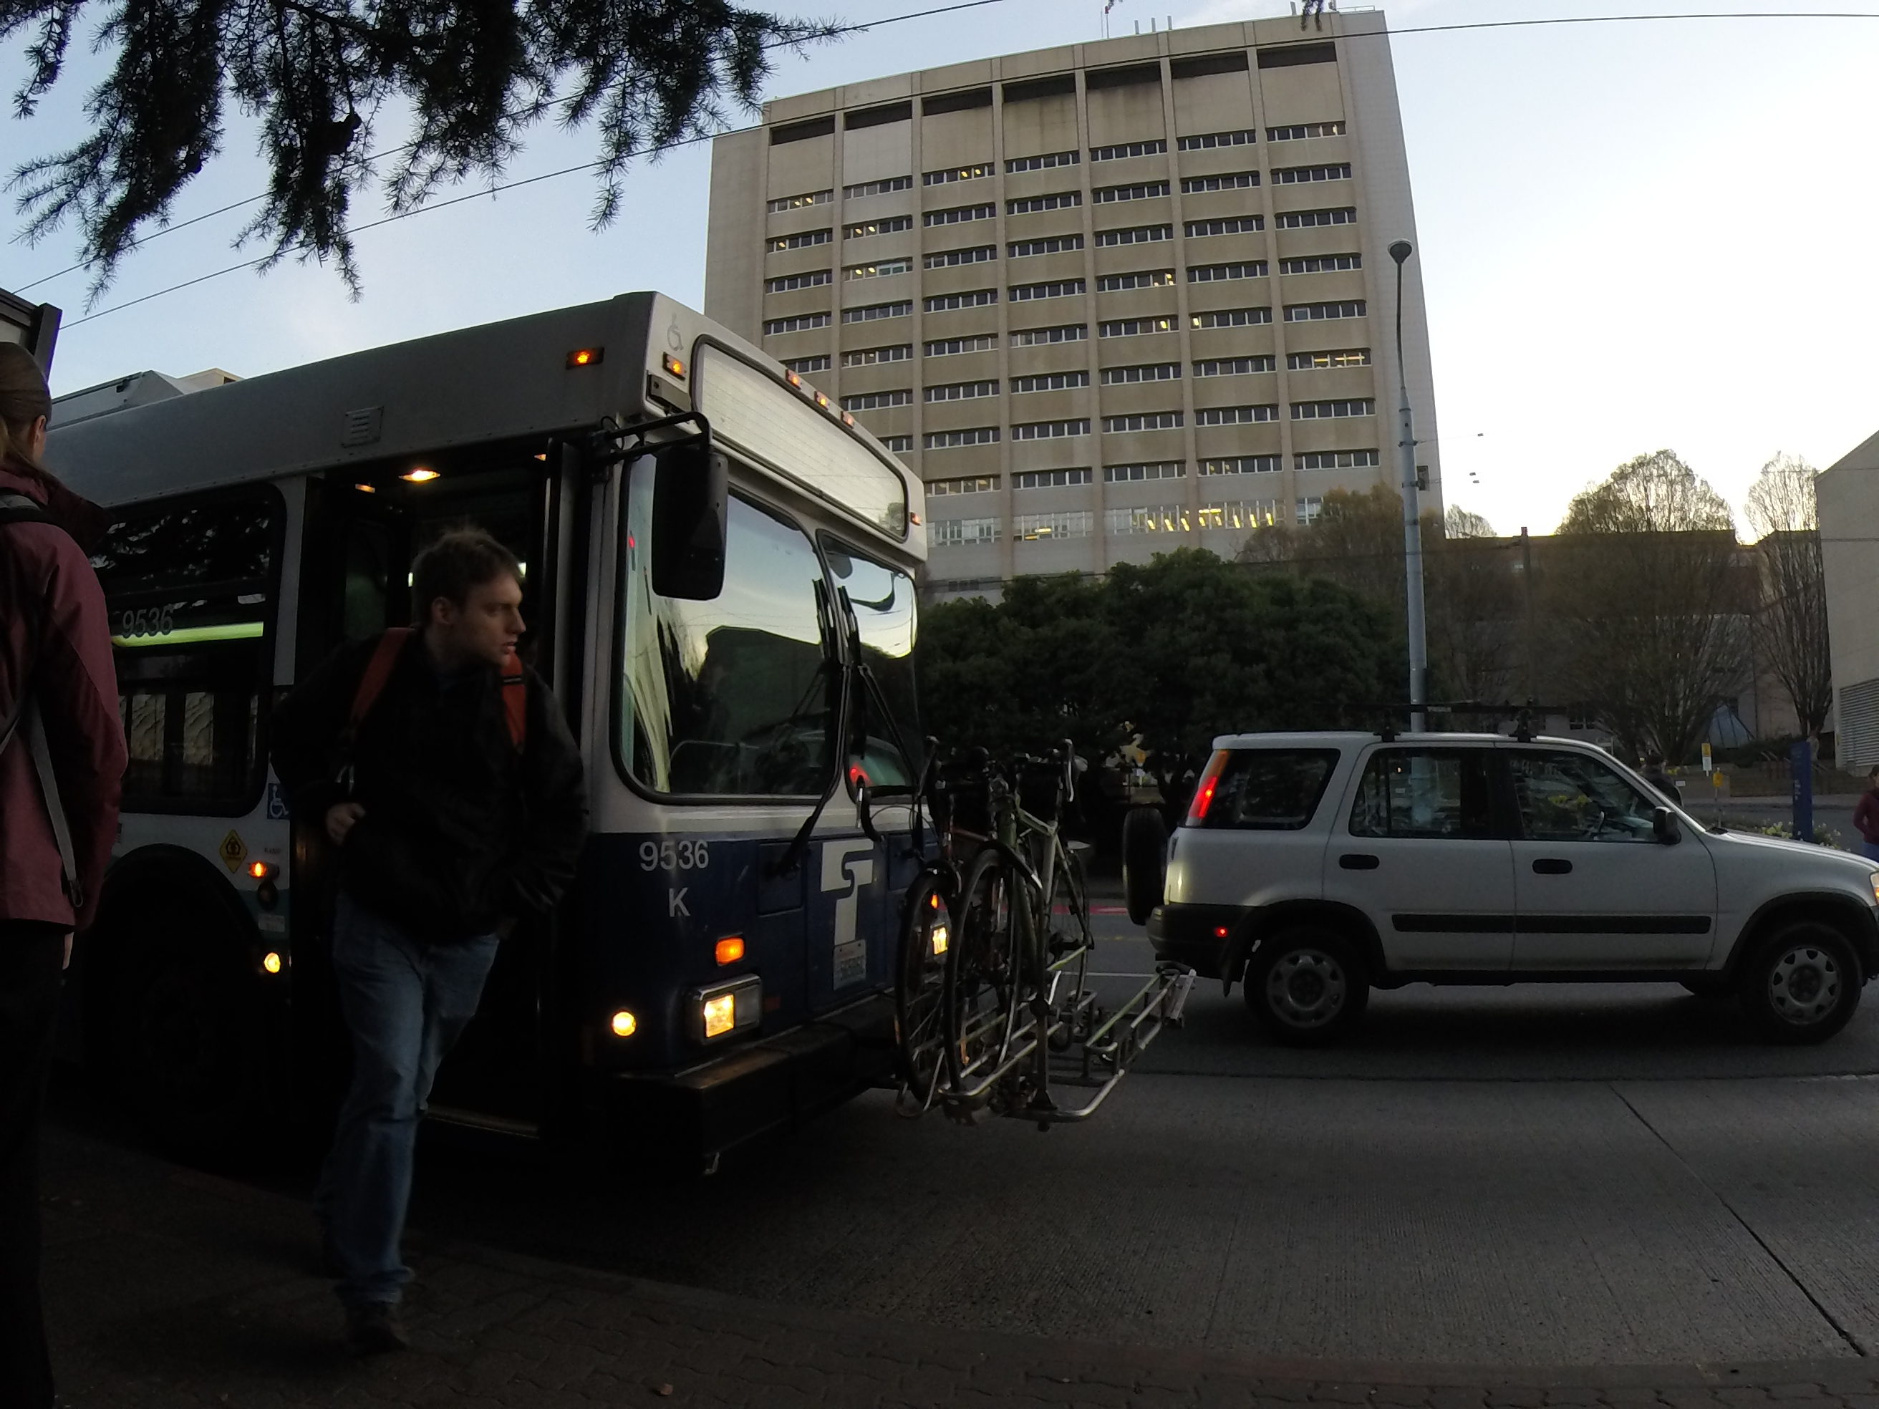
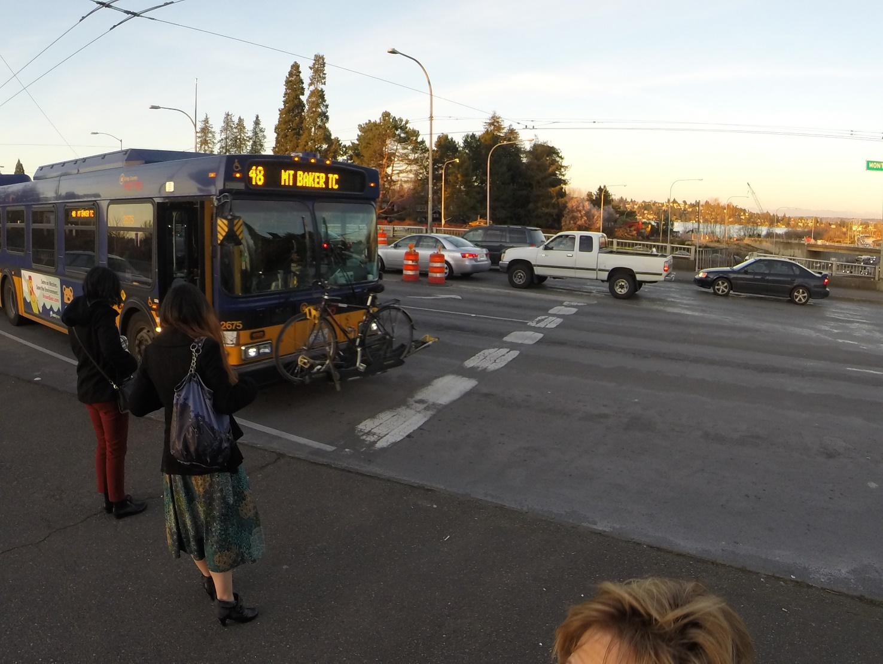
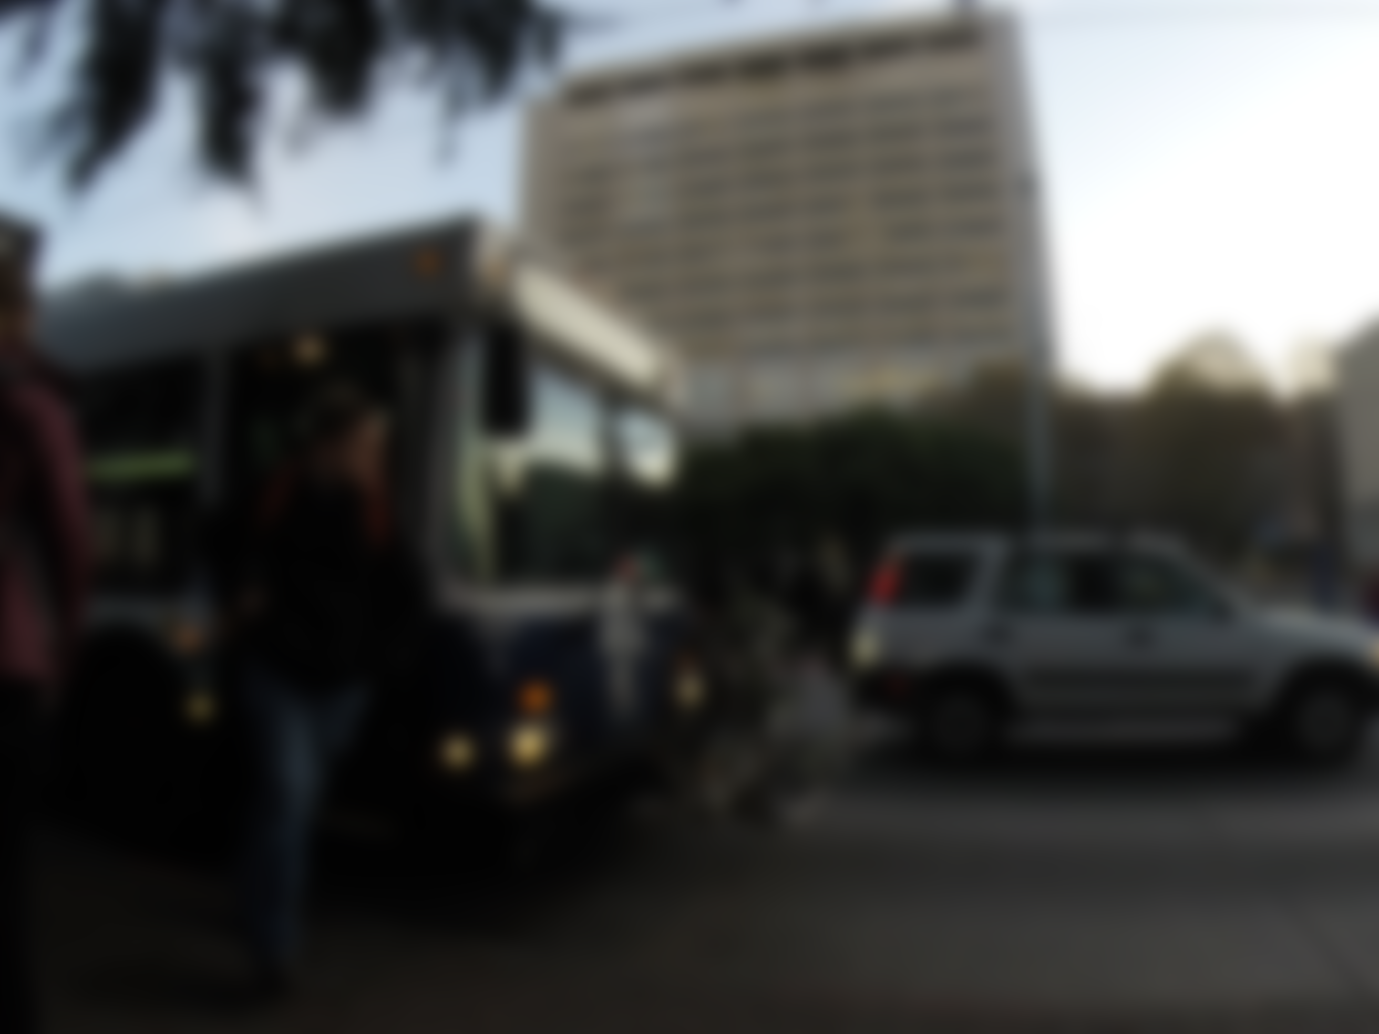
bus bike rack problems
Agencies:
how often and how much use?
Citizens:
rack empty? ☺ rack full? ☹

Slide 3

sense all the things
Sensors on buses = $$$
Cheap sensors at bus stops = ¢¢
sonar
+ cheap camera phone
+ Microsoft Azure cloud
+ Crowd workers
= ambient intelligence

Slide 4
Show diagram w/pictures of how it works
Video?

